Slide 1
Most Navigable Neighborhood in Pittsburgh
Team 32 – Gold ‘n Blue
Zezhong Chen, Matthew Kindja, & John Lovre
CMPINF 0010 – Spring 2024

Slide 2

What Makes a Great Neighborhood?
Cornerstones of
Effective Navigability:
Quality transportation
infrastructure
Ease of movement
Accessibility and safety

Slide 3



Metrics
Parking meters
Accessibility of public parking
Bus stops
Availability of public transportation
Walkability
Availability of foot transportation infrastructure

Slide 4
Parking Meters
Metric #1

Slide 5
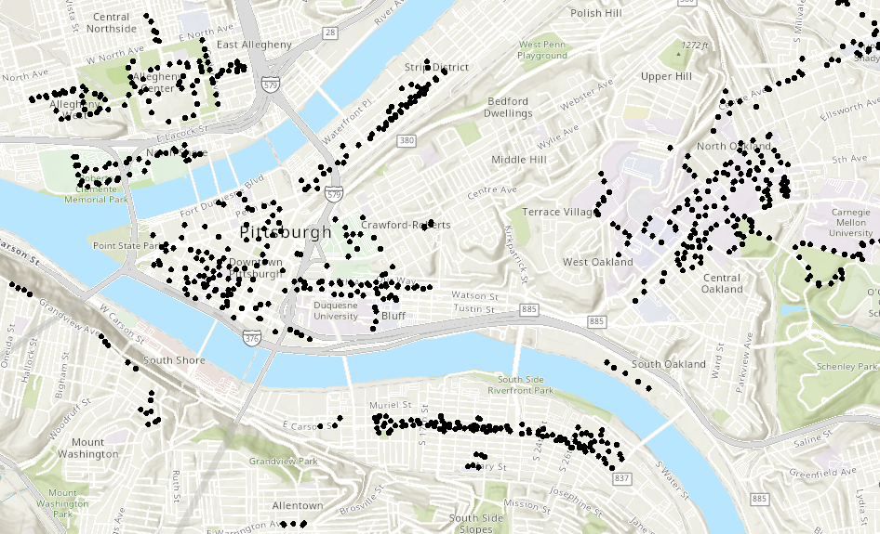
Parking Meters – Map of Locations
Source: https://pghgishub-pittsburghpa.opendata.arcgis.com/datasets/pittsburghpa::pittsburgh-parking-authority-terminals/explore

Slide 6
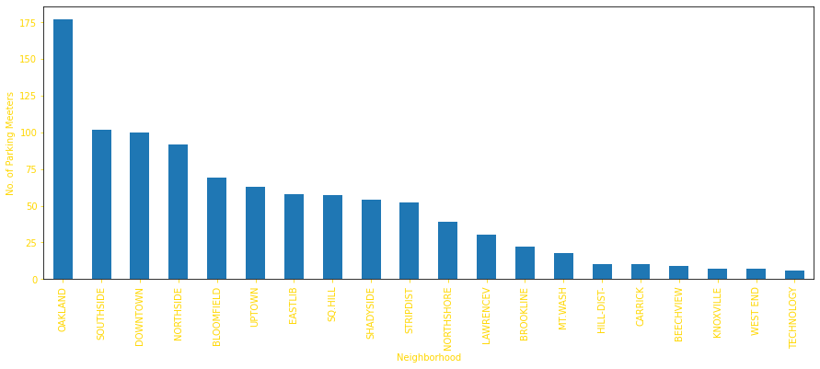
Parking Meters – Top 20 Neighborhoods
Why Parking Meters?
Parking meters are a representation of available on-street parking. On-street parking is important when traveling to and around a neighborhood to allow commuters and residents a place to safely leave their vehicles.
To see how we got these results click here…

Slide 7
Bus Stops
Metric #2

Slide 8
Bus Stops
Why bus stops?
Bus stops are crucial for community connectivity, offering essential access to public transportation. They support local economies, reduce environmental impact by lowering traffic and pollution, promote social inclusivity, and improve urban planning and safety.

Slide 9

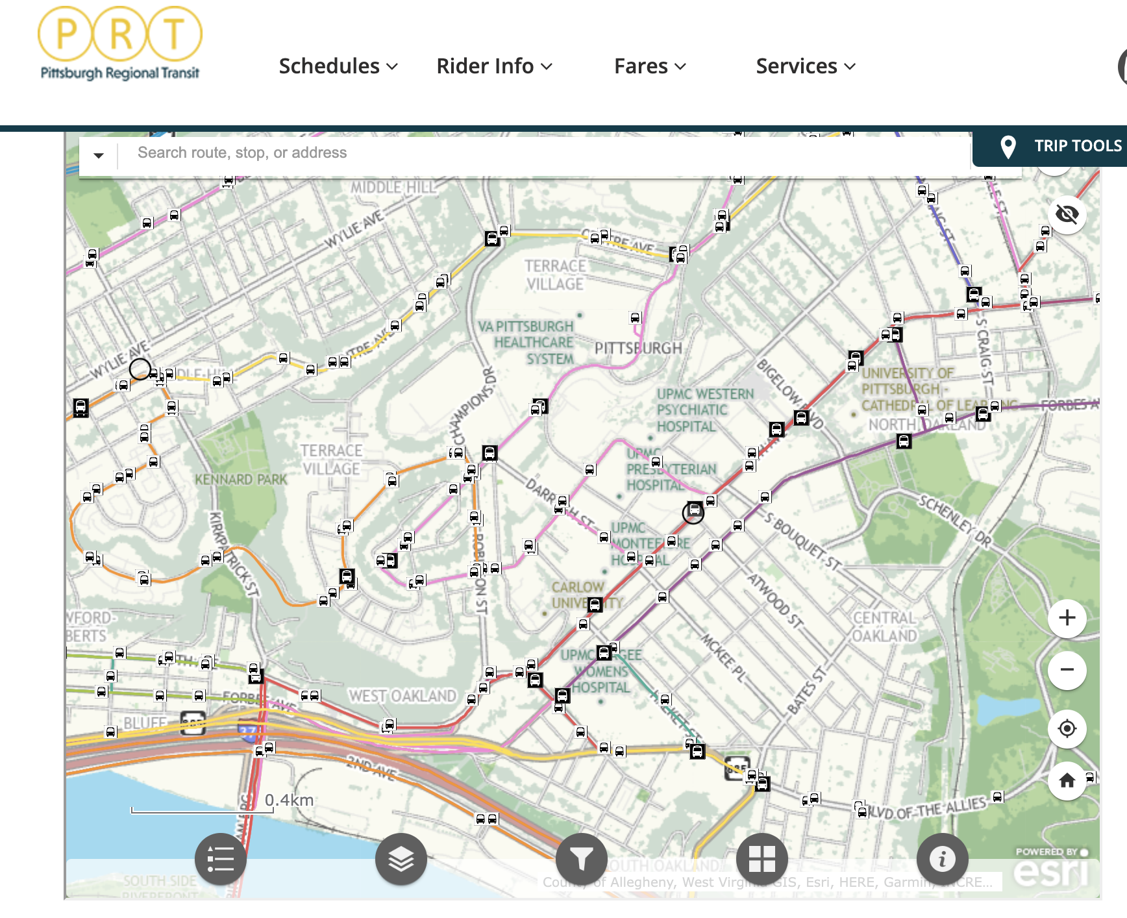
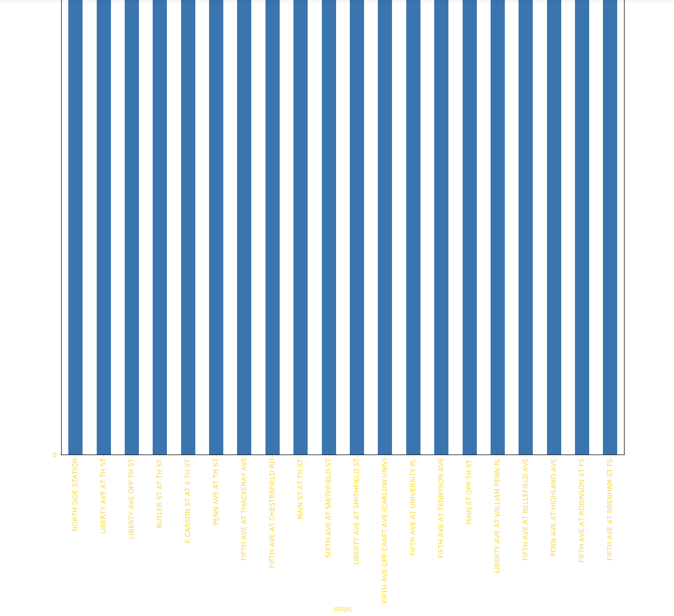
The graph
Safety
Ease of access
More reasonable

Slide 10
Walkability
Metric #3

Slide 11
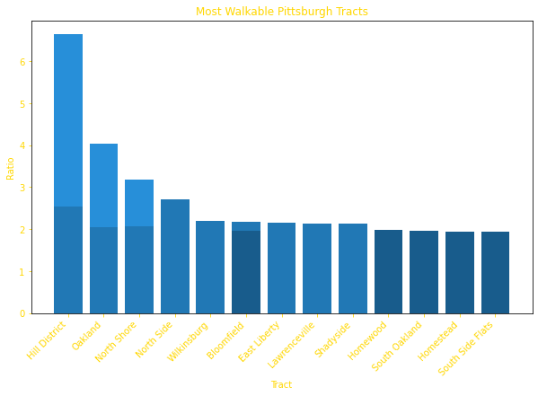
Walkability (Sidewalk ft. / Street ft.)
Why Walkability?
Crucial to city life
Encourages a healthy, active lifestyle
Notes:
ratio = sidewalk length / street length
Reliable transportation is crucial to city life. Access to the diverse arrangement of amenities found throughout Pittsburgh is imperative to a healthy, active life and participation is one’s community. Effective infrastructure for foot transportation affords citizens a comfortable way to enjoy the outdoors, something especially crucial in densely populated suburbs.
dark blue -> at least 2 factors of walkability
medium blue -> 2 to 3 factors of walkability
light blue -> greater than 3 factors of walkability

Slide 12
“[We’ve] found positive relationships between measures of walkability and either life satisfaction or happiness”
From Walkable Neighborhoods:
Linkages Between Place, Health, and Happiness in Younger and Older Adults
Leyden, K. M., Hogan, M. J., D’Arcy, L., Bunting, B., & Bierema, S. (2024). Walkable Neighborhoods: Linkages Between Place, Health, and Happiness in Younger and Older Adults. Journal of the American Planning Association, 90(1), 101–114. https://doi.org/10.1080/01944363.2022.2123382

Slide 13
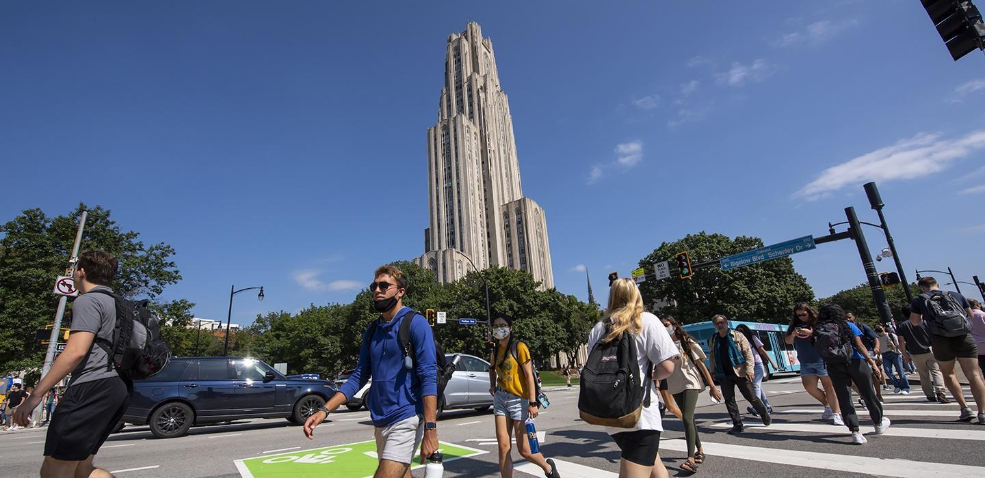
Conclusion – Most Navigable Overall
Oakland!
Notes:
How we determined: 1) Oakland contained the most number of parking meters per metric one. 2) Per metric two, Downtown and Northshore actually had the most bus traffic, but a closer look showed that Oakland actually had more efficient routes and was less congested. 3) Oakland was the second most walkable neighborhood per metric three…however, if you include the results for South Oakland into this count, it is very close to the top result, Hill District.

Slide 14
Datasets
Parking meters
https://data.wprdc.org/dataset/parking-meters-pittsburgh-parking-authority/resource/72fff5c4-5ef2-4437-9e40-e2d999d455ed
Bus stops
https://data.wprdc.org/dataset/prt-transit-stop-usage/resource/3f40b94b-4ac4-48f1-8c61-8439d2d2f420
https://www.rideprt.org/system-map/
Walkability
https://data.wprdc.org/dataset/sidewalk-to-street-walkability-ratio/resource/b90ccee1-c0aa-43b9-93e2-8a25e690c393

Slide 15

Questions?

